Slide 1
National Nutrition Month® 2024
NationalNutritionMonth.org
Notes:
Hello, my name is ___________________________, and I am a ________________________ (RDN, NDTR, intern, etc.).
I’m also a member of the Academy of Nutrition and Dietetics (Academy), the world’s largest organization of food and nutrition professionals.
Members of the Academy, including registered dietitian nutritionists (RDNs) and nutrition and dietetics technicians, registered (NDTRs), play a key role in shaping the public's food choices and are committed to improving the nation’s health.
As food and nutrition experts, RDNs serve in roles that have a positive impact on the health of their patients, clients and communities. RDNs offer preventive and medical nutrition therapy services in a variety of settings, and they are a trusted source about what types of food to eat.
NDTRs are also employed throughout the community in areas such as hospitals, public health clinics, nursing homes and more and use their nutrition knowledge to help people make positive lifestyle changes.

Slide 2
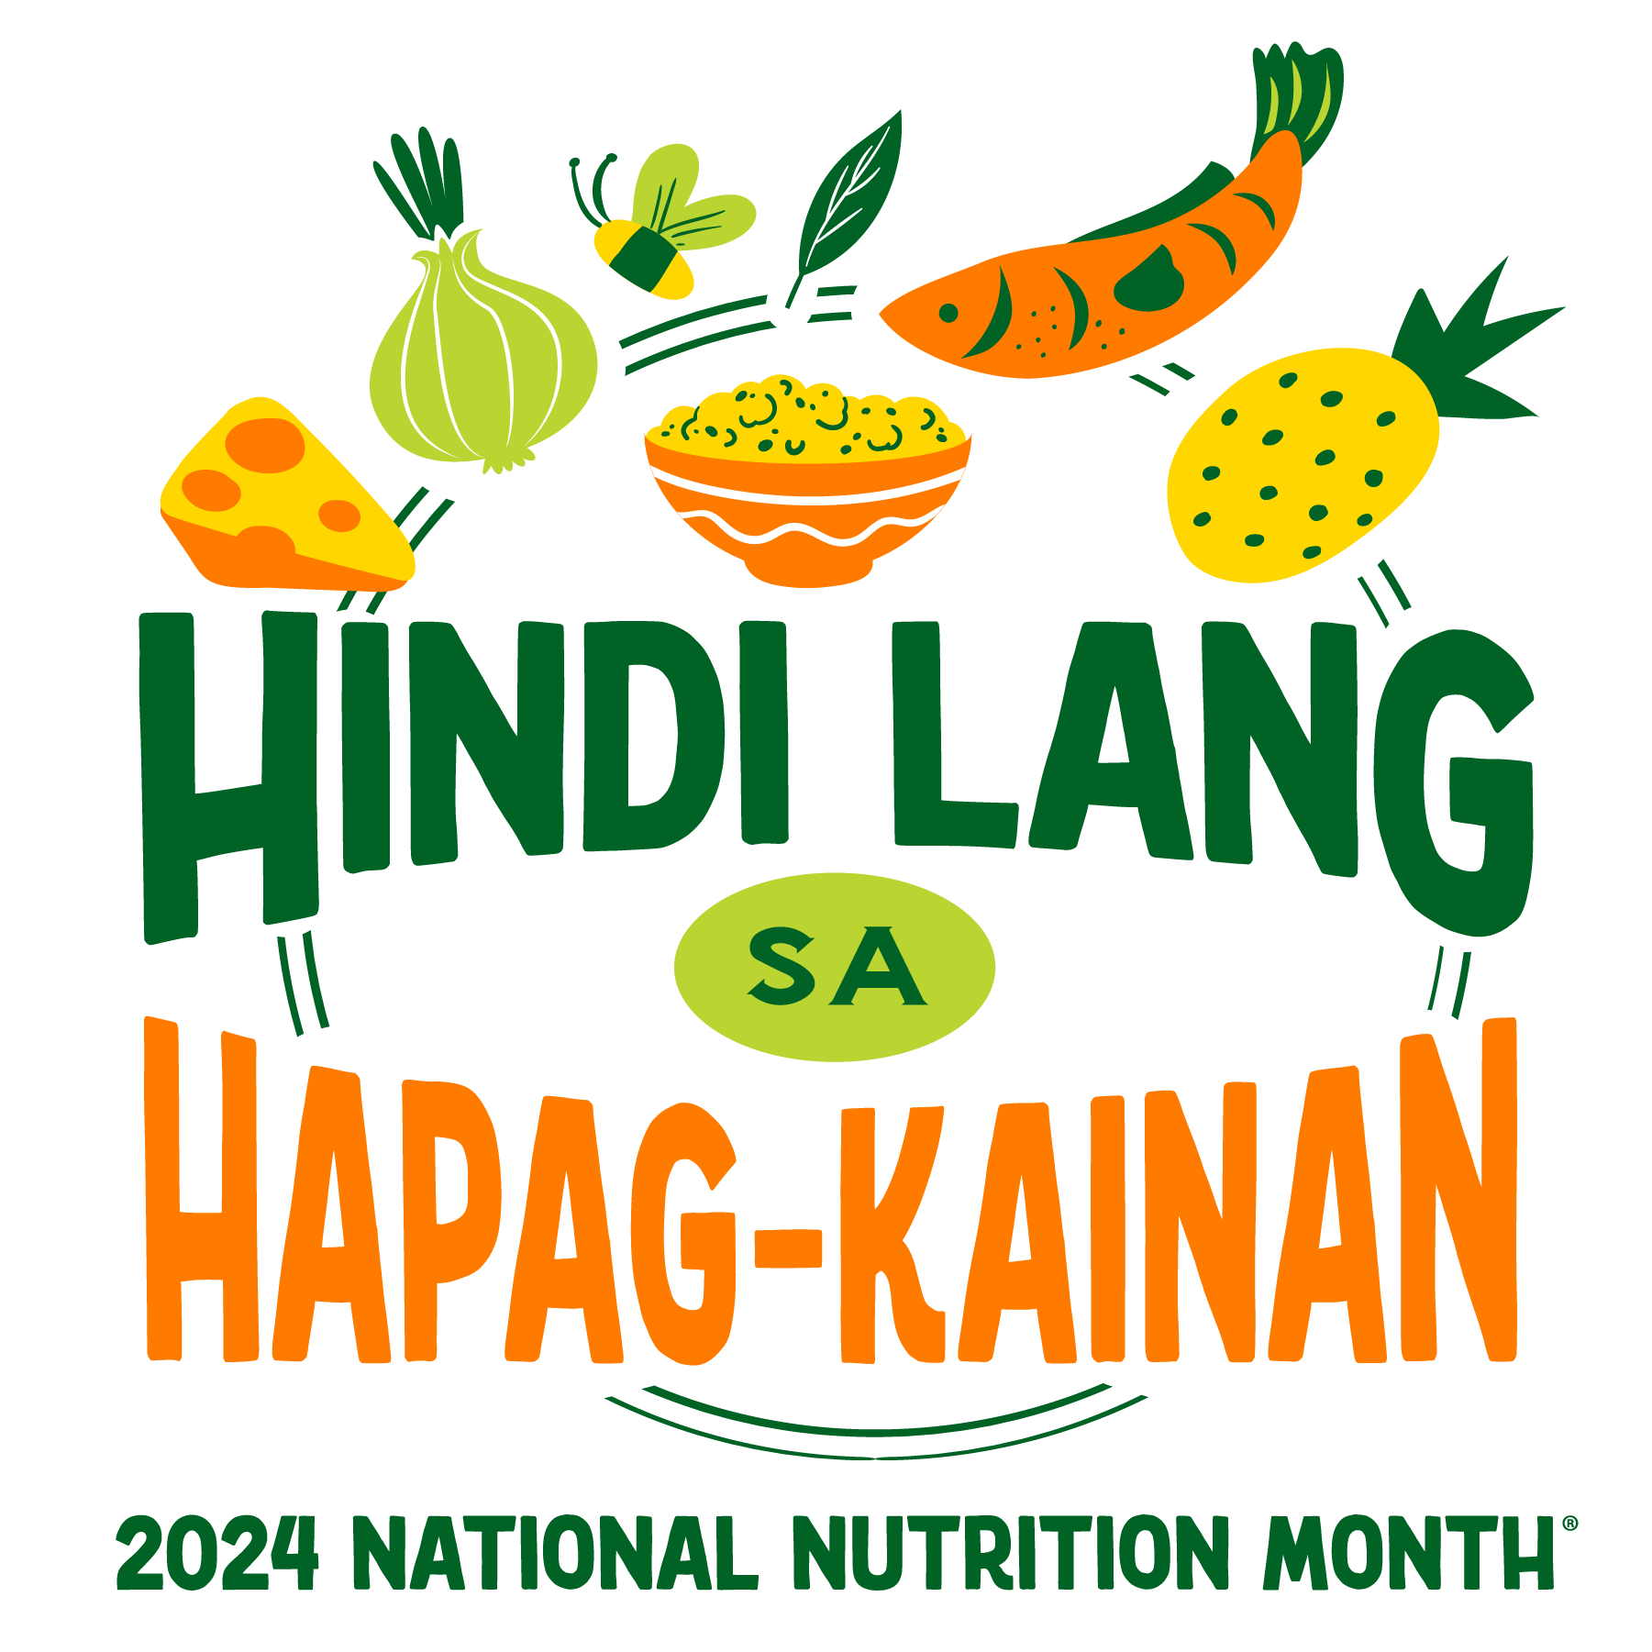
NationalNutritionMonth.org
Notes:
Each year during March, we celebrate National Nutrition Month®, which is a nutrition education and information campaign sponsored by the Academy. It invites everyone to learn about making informed food choices and developing sound eating and physical activity habits.
National Nutrition Month® started in 1973 as National Nutrition Week, and it became a month-long observance in 1980 in response to growing interest in nutrition.
The theme for National Nutrition Month® 2024 is Beyond the Table, which highlights the farm-to-fork aspect of nutrition; addresses the many ways and places we eat; emphasizes sustainability efforts; and showcases the expertise of nutrition and dietetics professionals.

Slide 3
Mga Layunin:
Ipaliwanag ang kahalagahan ng pagkain ng sari-saring pagkain mula sa lahat ng pangkat.
Tumukoy ng hindi bababa sa dalawang dahilan para makipagkita sa isang registered dietitian nutritionist.
Maglarawan ng tatlong paraan ng pagkain nang may pagsasaalang-alang sa kapaligiran.
Notes:
At the end of today’s presentation, you will be able to:
Explain the importance of eating a variety of foods from all food groups.
Identify at least two reasons for meeting with a registered dietitian nutritionist.
Describe three ways to eat with the environment in mind.

Slide 4
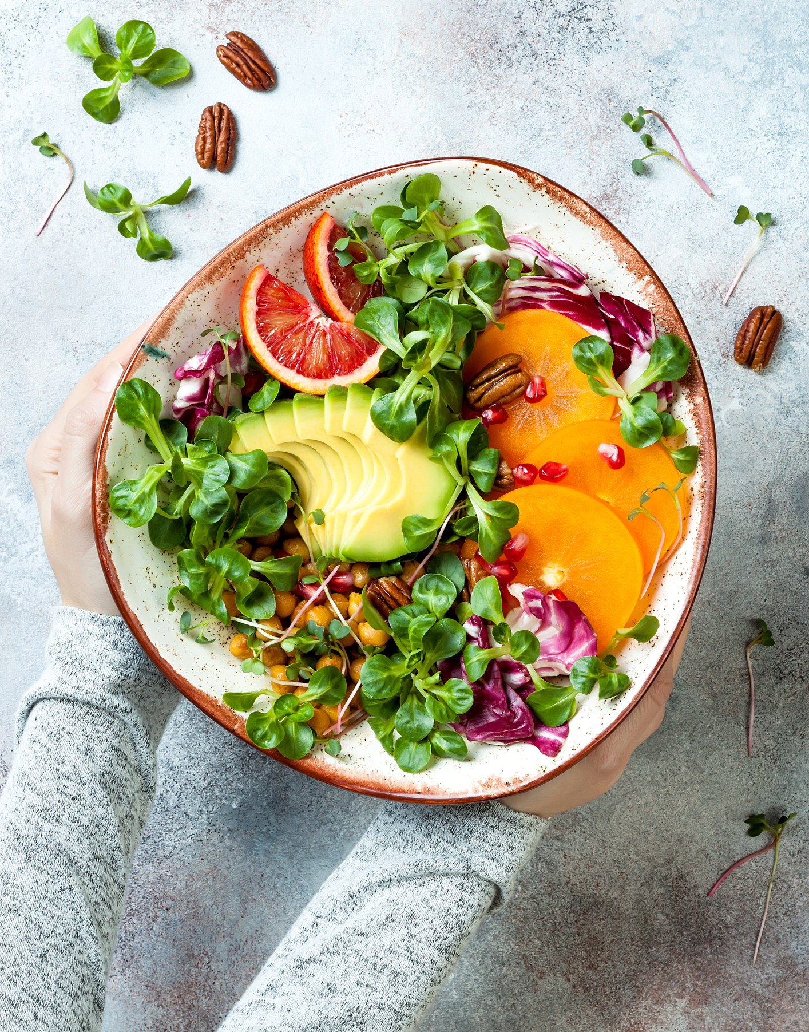
Kasanayang kumain nang masustansya.
NationalNutritionMonth.org
eatright.org
Notes:
A healthy eating routine may be a new phrase to some of you. It describes a way of eating that includes nutritious foods and drinks on a regular basis. This approach to eating is different than many fad diets, which promote unnecessary restrictions or require people to eat a certain way.
Healthy eating routines can vary, since we all have different food preferences, budgets, cooking skills, traditions, etc.
According to the 2020-2025 Dietary Guidelines for Americans, “a healthy eating routine is important at every stage of life and can have positive effects that add up over time”.
The great news is that we’re never too young or too old to adopt a healthy eating routine.
And what better time to start or improve your healthy eating routine than during National Nutrition Month®!
Source: U.S. Department of Agriculture and U.S. Department of Health and Human Services. Dietary Guidelines for Americans, 2020-2025. 9th Edition. December 2020. Available at DietaryGuidelines.gov.

Slide 5

Manitiling busog sa anumang badyet.
NationalNutritionMonth.org
eatright.org
Notes:
It may seem challenging at times to pick foods that are healthier, especially with the cost of so many goods increasing over the past few years.
Staying nourished on any budget may require more planning in advance in order to stretch your food dollars.
Let’s discuss a few ways that can help…

Slide 6
National Nutrition Month® 2024
Manitiling busog sa anumang badyet.
Matuto ng mga kasanayan sa pagluluto, paghahanda, at pagpaplano ng pagkain.
Gumamit ng listahang pang-grocery at mga sale sa tindahan kapag namimili ng pagkain.
Tuklasin ang mga tulong sa iyong pamayanan, tulad ng SNAP, WIC, at mga malalapit na food bank.
Sanayin ang ligtas na paghahanda ng pagkain sa bahay.
Notes:
Preparing foods at home allows you to control the ingredients, their amounts and how the foods are made. By learning cooking, food preparation and meal planning skills, you can identify ways to substitute lower cost ingredients, if need be, use lesser amounts in some cases, and increase the nutrition of many dishes.
For example, beans can be used in place of some or all of the meat that a chili recipe calls for and less salt can be used in many dishes.
Fruits and vegetables also can be incorporated into meals, making them more nutritious. All forms count, too – fresh, frozen, canned or dried.
A good place to start is with planning your meals and snacks. Before going to the store, check what foods you have at home, then use a grocery list and shop sales when purchasing the foods you need.
It may also help to learn about resources in your community, such as SNAP, WIC, and local food banks. These types of programs offer food assistance to individuals who are eligible.
SNAP stands for “Supplemental Nutrition Assistance Program” and WIC is a “Special Supplemental Nutrition Program for Women, Infants, and Children”. For more information about either program, visit the U.S. Department of Agriculture’s website at usda.gov.

Slide 7

Sanayin ang ligtas na paghahanda ng pagkain sa bahay.
NationalNutritionMonth.org
eatright.org
Notes:
Practicing home food safety also relates to nourishment and is especially important for individuals who are at higher risk of foodborne illness, also known as food poisoning. Infants, older adults and people with certain health conditions, like diabetes and cancer, and individuals who are pregnant are at increased risk of foodborne illness.
Steps you can take to keep food safe at home include:
Washing your hands with soap and water before preparing or eating food. Cleaning surfaces that are used to prepare foods is also important.
Keeping raw foods separate from foods that are already cooked or ready-to-eat. This may involve using different cutting boards and utensils when preparing these foods to prevent what is known as cross-contamination.
Cooking foods to their appropriate internal temperature is also needed. Using a food thermometer is the only way to make sure that a food is cooked thoroughly and is safe to eat.
Refrigerating perishable foods right away helps to keep them out of the Temperature “Danger Zone”, where bacteria multiply at a faster rate. Foods left out at room temperature for two hours or longer are unsafe to eat. (One hour if the temperature is 90° Fahrenheit or higher).
For more Home Food Safety Tips, visit eatright.org.

Slide 8
Kumonsulta sa isang Registered Dietitian Nutritionist (RDN).
Humingi ng referral sa iyong doctor para sa isang RDN.
Maghanap ng RDN na may espesyalisasyon sa iyong mga natatanging pangangailangan.
Makatanggap ng naka-personalize na impormasyon sa nutrisyon upang makamit ang iyong mga layunin sa kalusugan.
Tuklasin ang iba’t ibang paraan na makatulong ang mga RDN na magkaroon ng mas magandang kalusugan ang mga tao.
NationalNutritionMonth.org
Notes:
Registered Dietitian Nutritionists are experts in food safety, but there are many other reasons to see an RDN.
Common reasons to consult with an RDN include:
You want help managing diabetes, high blood pressure or another chronic disease.
You are thinking of having or have had gastric bypass surgery.
You have digestive problems and are concerned about eating.
You’re pregnant, trying to get pregnant, or are a new parent.
You have a food allergy or intolerance.
You or your child is experiencing disordered eating.
You’re caring for an aging parent.
You want practical lifestyle advice.
You want to improve your performance in sports.
You’re interested in feeding your family healthier foods, but you do not cook.
You may have to ask your doctor for a referral to an RDN and be sure to find an RDN who specializes in your unique needs.
By seeking the help of an RDN, you’ll receive personalized nutrition information to meet your health goals.
National Nutrition Month® is a great time to learn about the many ways RDNs can help people live healthier lives.
Visit eatright.org to Find a Nutrition Expert in your area.

Slide 9
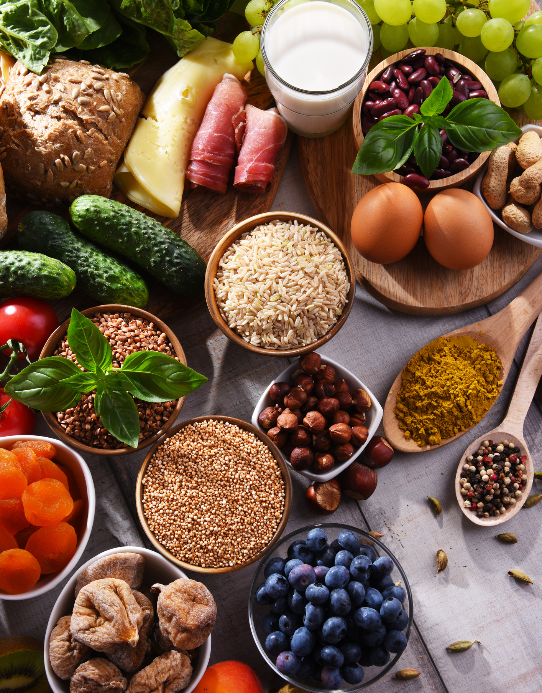
Kumain ng sari-saring pagkain mula sa lahat ng pangkat ng pagkain.
  Prutas
  Mga Gulay
  Mga Butil
  Protina
  Mga Produkto Mula sa Gatas
NationalNutritionMonth.org
eatright.org
Notes:
RDNs are skilled at helping people adopt a healthy eating routine, which we discussed earlier. This way of eating includes a variety of nutritious foods from all of the food groups, (fruits, vegetables, grains, protein foods, and dairy) in the recommended amounts and within calorie limits.
The foods we choose, how they’re prepared and the amounts we eat will vary.
It’s important to remember that no one food or food group offers all the nutrients we need. So, eating a variety of foods from each food group and within each food group on a regular basis offers an assortment of nutrients that our bodies need for good health.

Slide 10
National Nutrition Month® 2024
Kumain ng sari-saring pagkain mula sa lahat ng pangkat ng pagkain.
Isama ang iyong mga paboritong nakasanayang pagkain at tradisyon.
Kumain ng iba’t ibang anyo ng mga pagkain tulad ng sariwa, frozen, nakalata, at pinatuyo.
Mag-eksperimento ng mga recipe gamit ang iba’t ibang sangkap.
Sumubok ng mga bagong pagkain at mga luto mula sa iba’t ibang bansa.
Notes:
Including your favorite cultural foods and traditions can be an important part of a healthy eating routine. It allows you to adapt healthful eating recommendations to include foods which reflect your personal preferences and culture.
You can also eat foods in various forms, which can help keep food costs down. For example, when fresh produce is not in season, buying canned or frozen fruits and vegetables is a convenient way to include these foods. Remember to look for nutrient-dense forms, meaning those that have little added sugars, saturated fat, and sodium.
Other ways to include a variety of foods is to experiment with recipes using different ingredients and to try new foods or global cuisines.

Slide 11
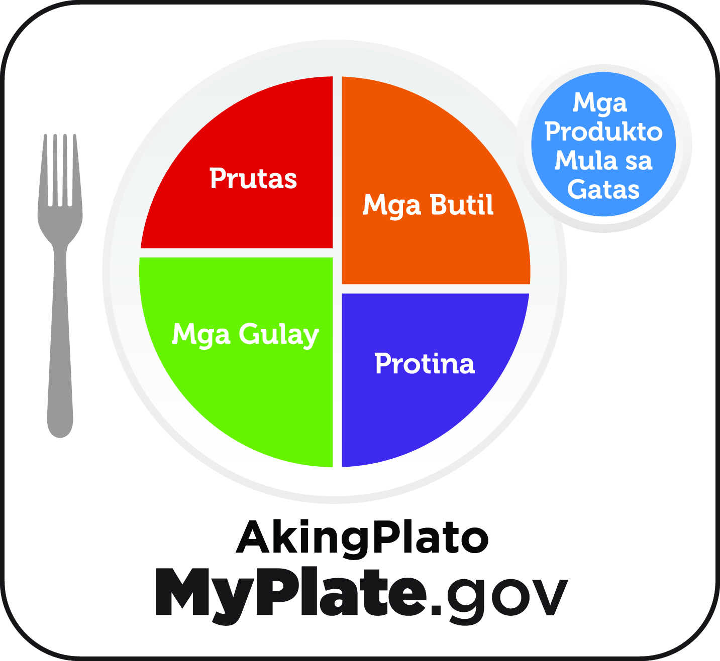
MyPlate
Notes:
Another great resource that can assist with eating a variety of foods from all food groups is the USDA’s MyPlate.
MyPlate encourages us to balance our meals so that half of the plate includes fruits and vegetables, and the other half features a protein food and grain. A serving of dairy completes the meal.
It’s also important to note that some meals will contain a mixture of foods from several food groups, so they may not be portioned out in this way. Or the meal may be eaten out of a bowl. In either case each food group could be included.
For example, a soup that is made with chicken, noodles, and vegetables would satisfy three of the food groups – a protein food, grain, and vegetables. And for dessert, a low-fat yogurt parfait with fruit would be a way to make sure that the other two food groups were included.
For more information about MyPlate, visit MyPlate.gov.

Slide 12

Kumain nang may malasakit sa kapaligiran.
NationalNutritionMonth.org
eatright.org
Notes:
Our food choices also can affect the health of our planet. That’s why it’s important to eat with the environment in mind.
Make a point to learn what’s involved in growing your food. Visit a local farm or farmers market and talk with the people who are growing and harvesting your food.
Finding ways to reduce food waste will also help.

Slide 13
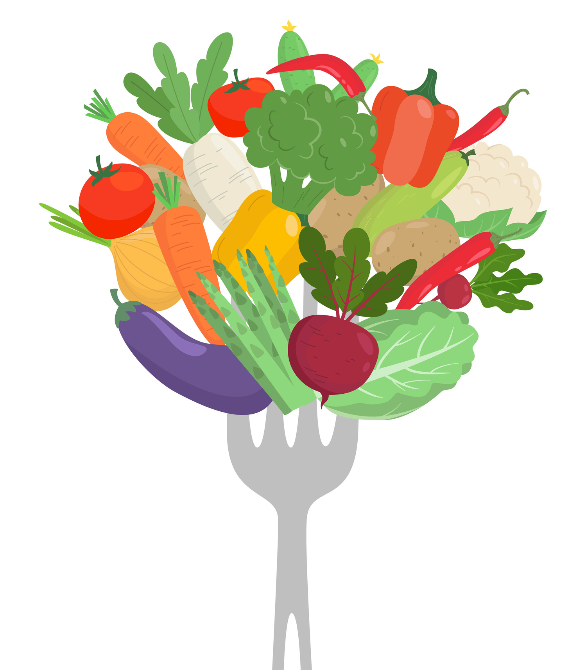
National Nutrition Month® 2024
Kumain nang may malasakit sa kapaligiran.
Maging malikhain sa mga natirang pagkain at mga paraan upang bawasan ang mga nasasayang na pagkain.
Dalasan lalo ang pagkain ng mga ulam at meryenda na mula sa mga halaman.
Bumili ng mga pagkaing napapanahon at sa mga lokal na magsasaka kung maaari.
Magtanim ng pagkain sa bahay o kaya sa tanimang pampubliko.
Notes:
Reach beyond the table when eating with the environment in mind.
Examples include:
Getting creative in the kitchen and creating new dishes from leftovers to help reduce food waste.
Enjoying more plant-based foods with meals and snacks. (Hint: planning in advance will help you do this.)
Support farmers by buying locally grown and seasonal foods, when possible.
You could also try growing your own fruits and vegetables at home. If space is limited, schools, churches and other places may offer community gardens where you can participate in the growing process and share in the harvest.

Slide 14

Humanap ng bihasa sa nutrisyon sa eatright.org
Notes:
Remember that a healthy eating routine is one that meets your unique needs.
There are many ways to eat healthfully Beyond the Table.
If you would like to improve your current eating habits and would benefit from personalized nutrition guidance, a registered dietitian nutritionist can help you develop a healthful eating routine that is as unique as you are.
For additional food and nutrition information and to Find a Nutrition Expert in your area, visit eatright.org.

Slide 15

National Nutrition Month® 2024
May mga tanong ba kayo?
Notes:
Are there any questions?

Slide 16

Maraming Salamat!
NationalNutritionMonth.org
eatright.org
Notes:
Thank you!

Slide 17
National
Nutrition Month®
NationalNutritionMonth.org
Notes:
And have fun celebrating National Nutrition Month®!

